Slide 1
PHOENIX CABLES INC.
OVERVIEW

Slide 2
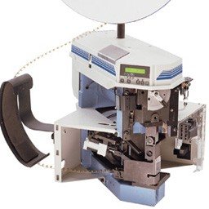
COMPANY BACKGROUND
Founded in 1989 by the Roberto/Heptinstall family, Phoenix Cables Inc. (www.phoenixcablespr.com) is a privately owned manufacturer of Custom Cable and Electronic assemblies and currently a supplier to several major OEM’s in both the Electronic and Industrial Power industries. We are known for our responsiveness and dedication to all our customers and have been quite successful in both Puerto Rico as well as the US mainland where Phoenix had its beginnings back in the early 70’s.
Phoenix Cables Inc. currently serves over 15 customers in the Power Distribution, Digital Energy and Electronics Industries and employs 35 people in the greater Aguadilla area.
MISSION STATEMENT:
Our mission is to achieve Superior Customer Satisfaction and Long-Term Strategic Alliances through outstanding Customer Focus.
SERVICES and PRODUCTS PROVIDED:
Custom Assemblies built to customer specs
Injection Molding (Over-molding)
Turn-key Solutions
Value Added Services
CERTIFICATIONS and MEMBERSHIPS:
Member PRMA
UL / CSA Certified
ISO9001:2016 Registered

Slide 3
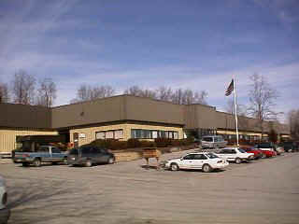
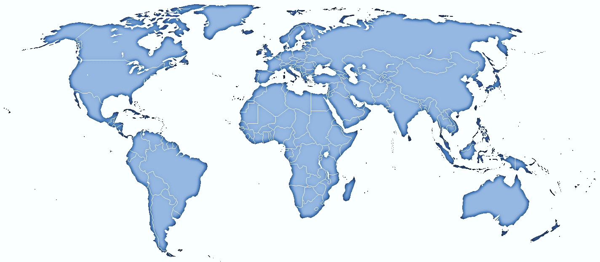
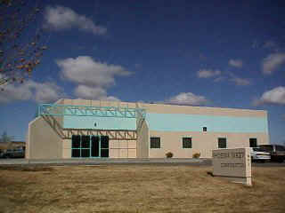
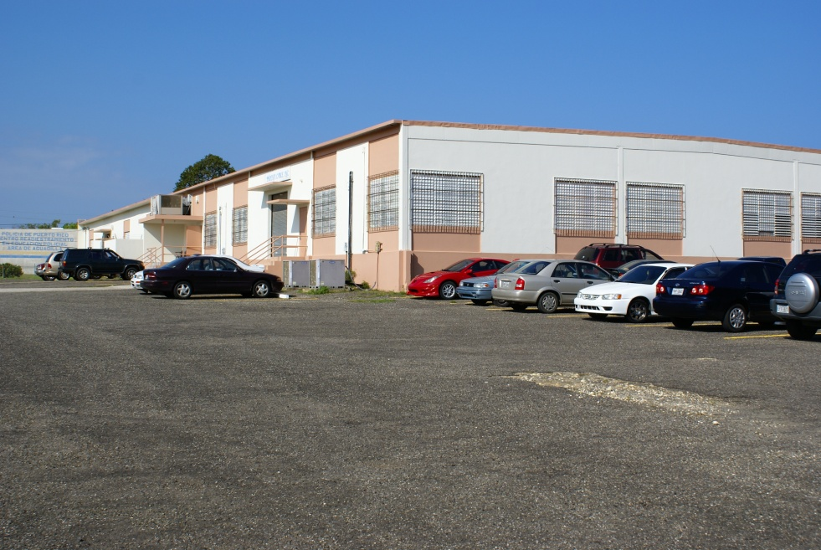
1 of 3 Companies
LOCATIONS –
Phoenix Electronics Enterprises
Highland, NY (Corporate Headquarters)
Phoenix West
Rio Rancho, NM
Phoenix Cables Inc. Aguadilla, PR

Slide 4
ORGANIZATIONAL STRUCTURE
Manager General Operations
Phoenix Cables Inc. Puerto Rico
Information Technology
(Corporate)
Accounting
Customer Service
Quality Assurance
Production
Purchasing
Document Control
Shipping/Receiving
Group Leader
Stockroom

Slide 5
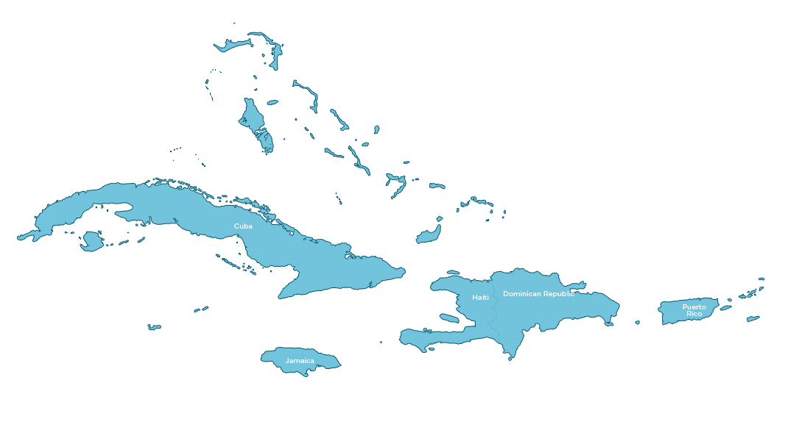
Site Overview: Puerto Rico
CAPACITY & CAPABILITIES
Experience | 40+ years Cable Assembly Experience
Revenue | $2.5 MM/Yr – PR (20 MM/Yr) corporatewide
Customers - PR | Aerospace Southwest APC (Worldwide) APW Cardinal Health Digital Network Products Group Eaton (Cutler Hammer) EBI (Electro-Biology Inc.) Flight Systems General Electric Ind. (ABB-Various Divisions) Hewlett Packard IMS (Anixter) Jabil (Worldwide) Keytronics Electronics Lift Microchip Sanmina Ultra Clean Technology
Markets Served | Communications Telecommunications Electronics Aerospace Military Medical Equipment Industrial Equipment Power Distribution Automotive Surveillance Equipment
Products | Cable and Harnesses Over-molded Assemblies Box Builds
Date Founded
1989 (PR Location)
Headcount
35 employees-PR, 150 + worldwide
Location
Mfg. Space
12,500 sq ft
Services Offered
Design Services
Braided Assemblies
Over-molding
Current
Capability
Prototypes
Surface Mount
No Current Capability
PCBA and Test
Enclosures
Systems Integration
Global Shipping

Slide 6
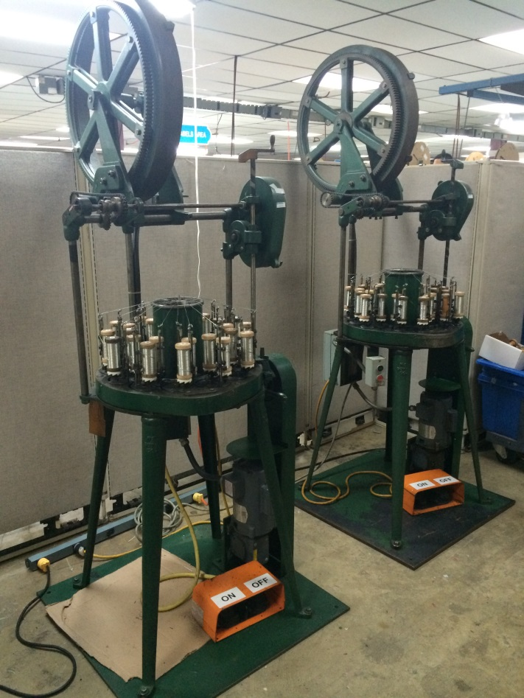
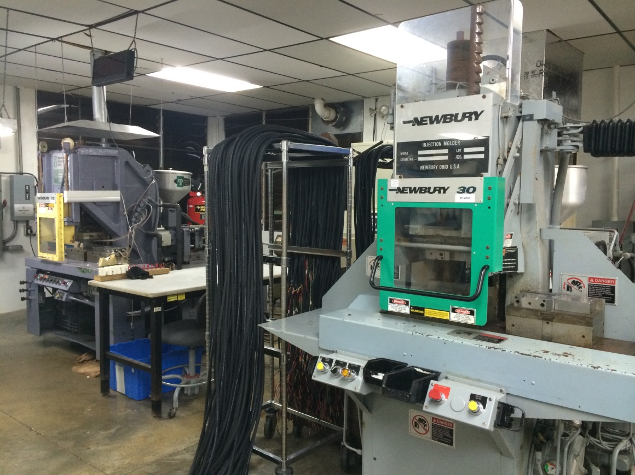
CAPACITY & CAPABILITIES
Injection Over-Molding
Braided Cable Assemblies

Slide 7
QUALITY STATEMENT
Phoenix is committed to:
“Total Customer Satisfaction”
Regardless of volume we cater to our customers needs to deliver Quality products how they need it, when they need it and at a cost that’s competitive.

Slide 8
OUR STRENGTHS
High Mix – Low to Moderate Volume as well as High Volume
Small to medium size locations enabling quick responses
Design Critique
Quick turnarounds
Short Lead-Times

Slide 9
CUSTOMER SATISFACTION
We realize that whenever one considers the possibility of a new supplier, no matter what the commodity, it requires learning about that supplier and their capabilities.
Those who can most accurately relate the performance of any given supplier are their customers.
Here we have included a few of our major customers along with contact names and phone numbers.
Feel free to contact any of them and I’m sure that you will be more than satisfied with their approbation.
Customer Contacts
Scott Dunlop (860) 282-5350
Marty Leach (860) 282-5355
Joyce Fernandez (787) 609-6198 ext. 1009
José J. Figueroa (787) 881-3640
Jennifer Rurup (303) 539-4947
IMS (Anixter)
MHL Custom Inc.
Eaton Corp.
Microsemi

Slide 10
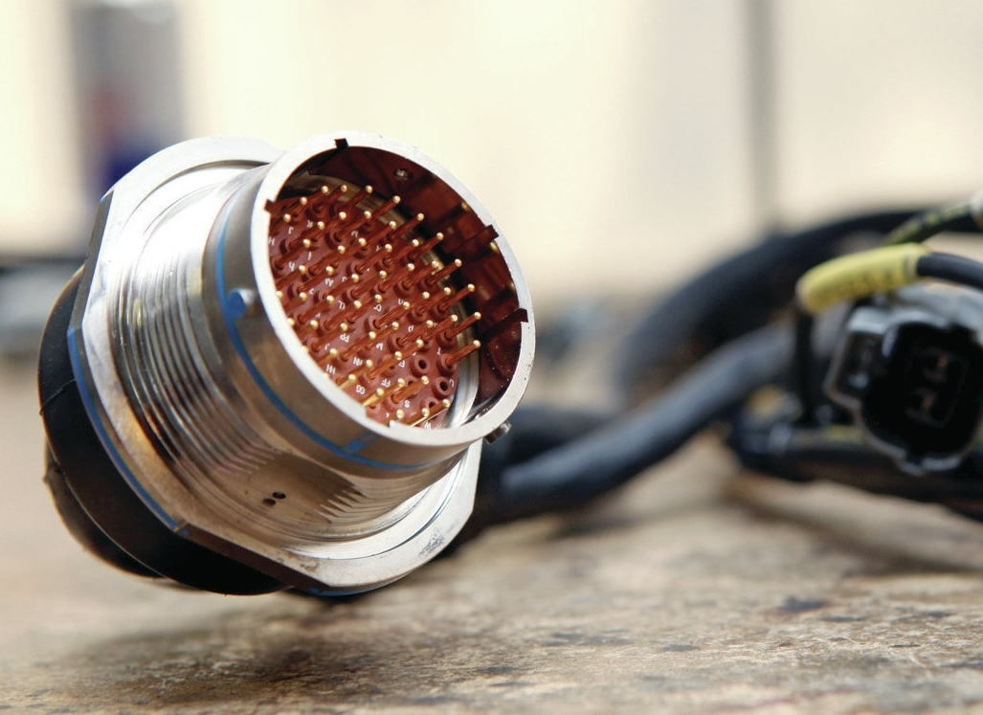
SOME OF OUR PRODUCTS

Slide 11
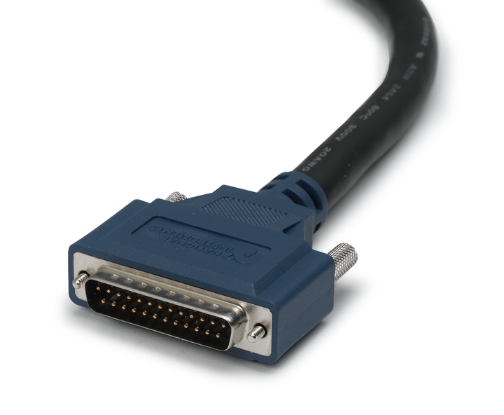
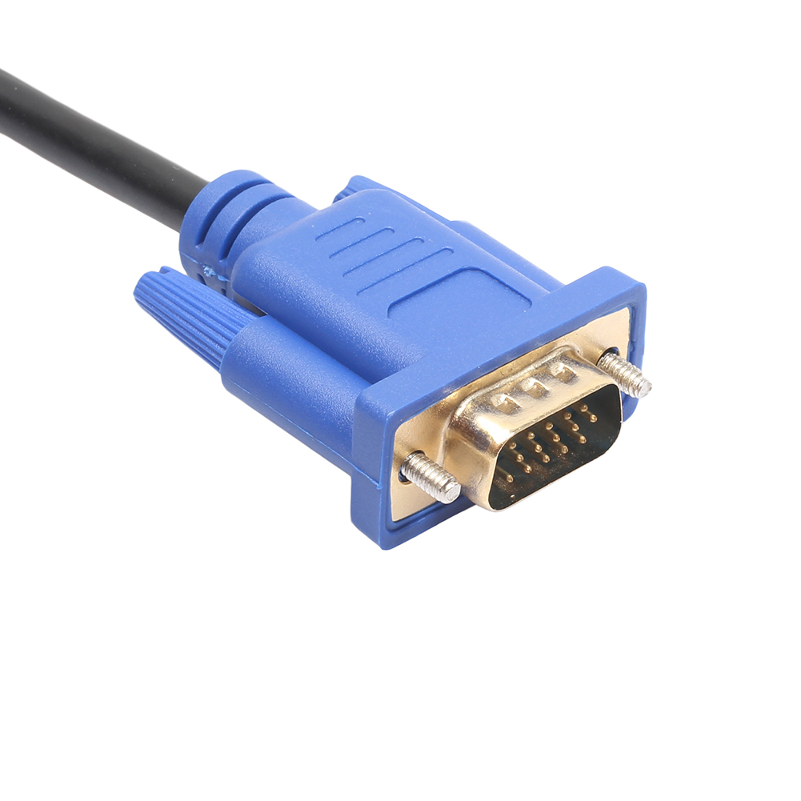
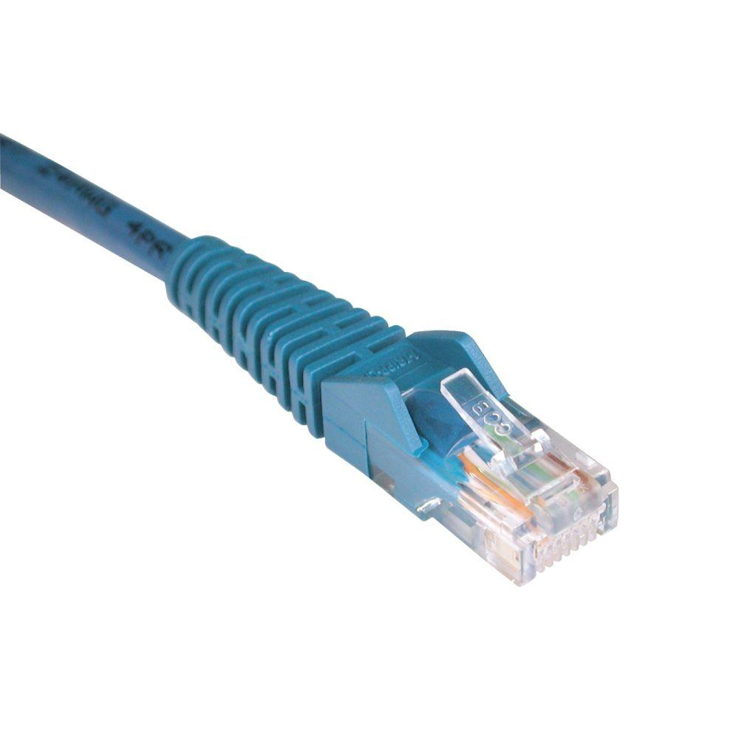
OVERMOLDED ASSEMBLIES

Slide 12
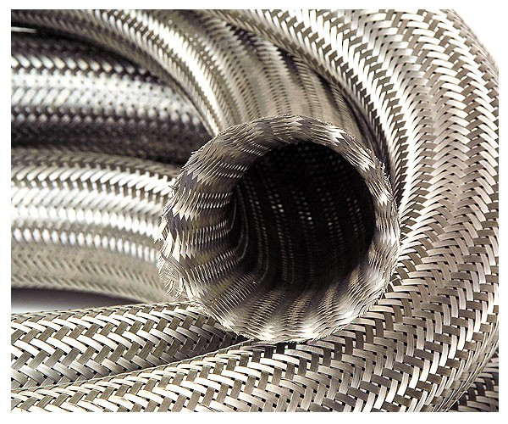
BRAIDED ASSEMBLIES

Slide 13
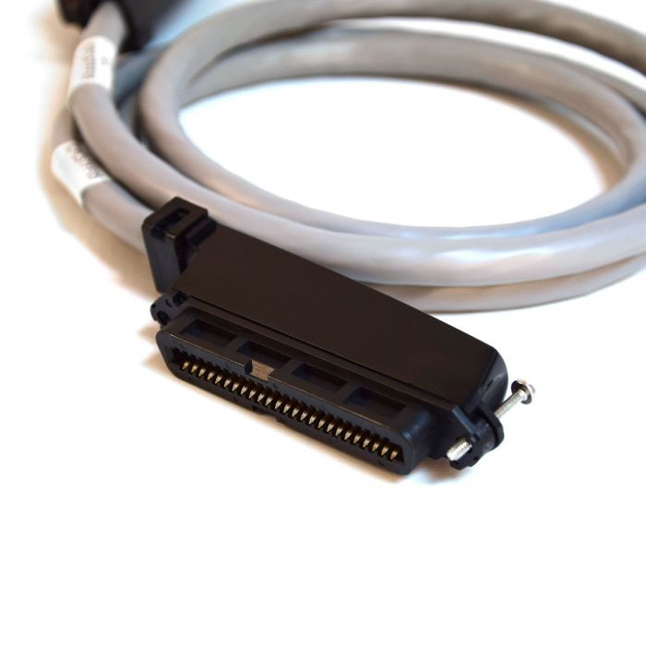
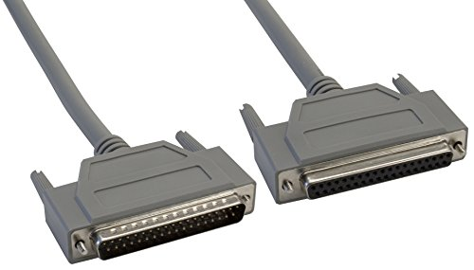
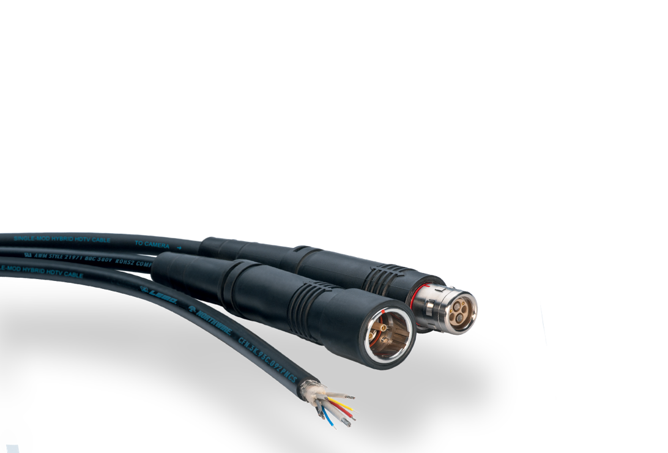
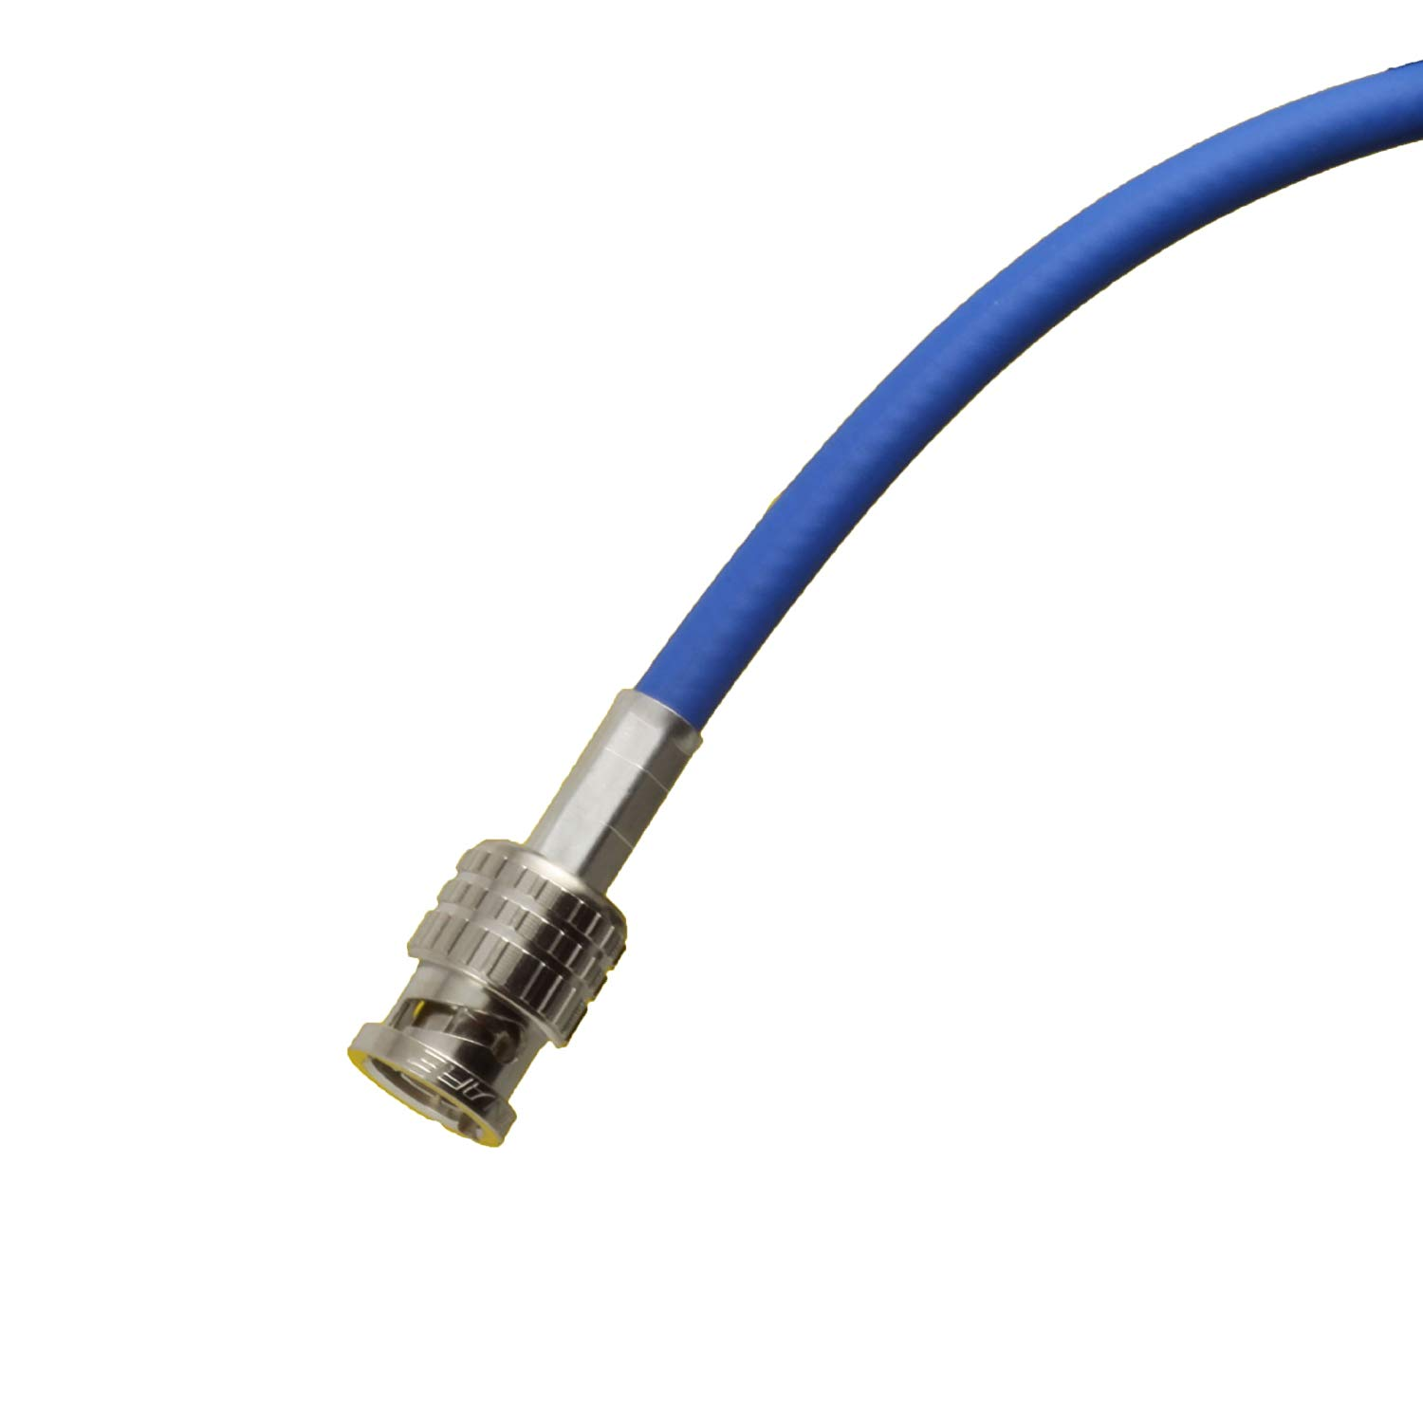
IT ASSEMBLIES

Slide 14
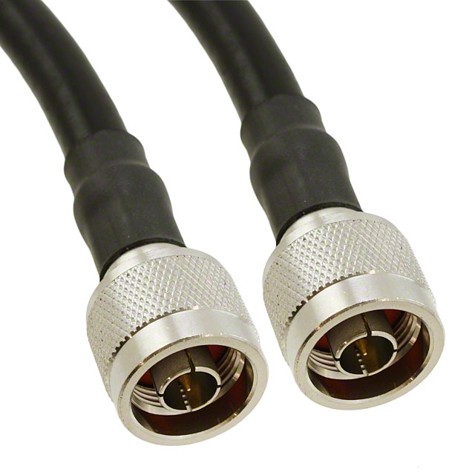
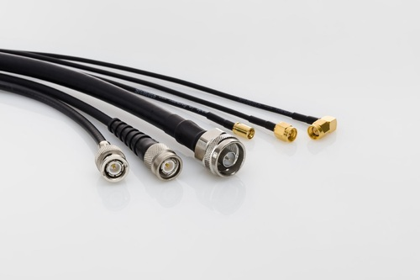
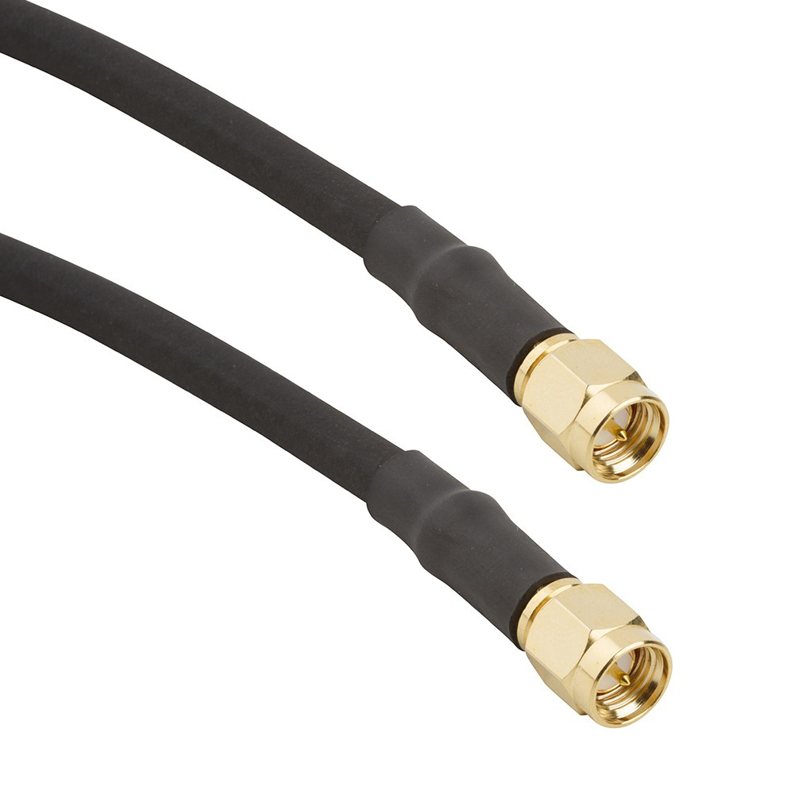
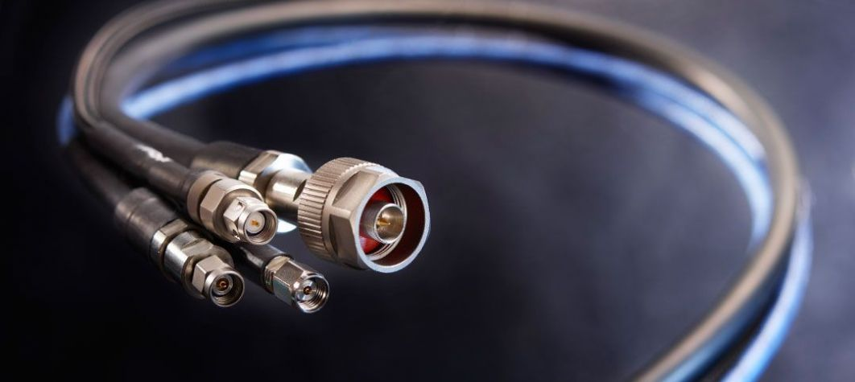
rf ASSEMBLIES

Slide 15
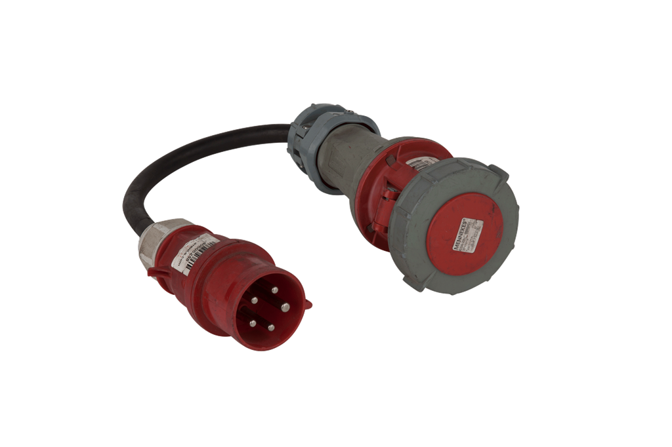
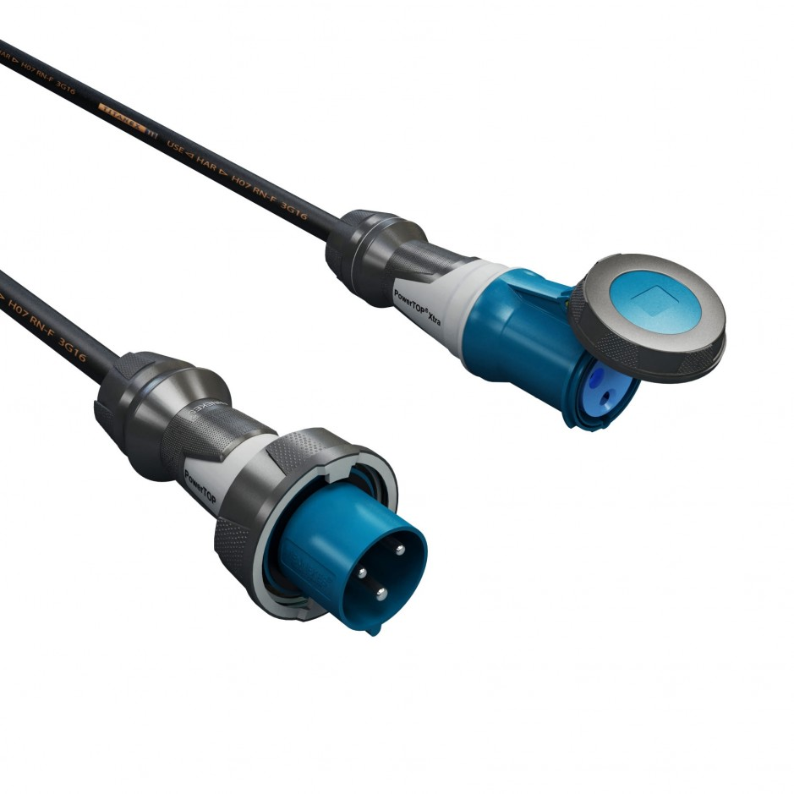
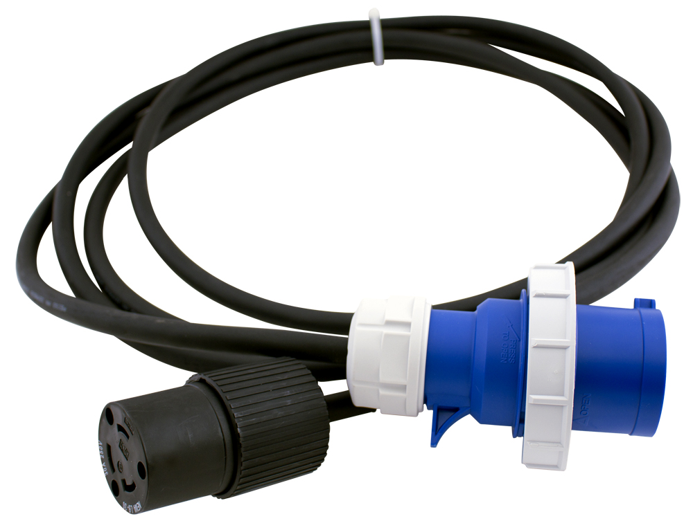
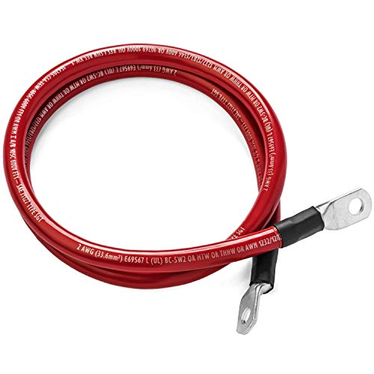
LARGE AWG ASSEMBLIES

Slide 16
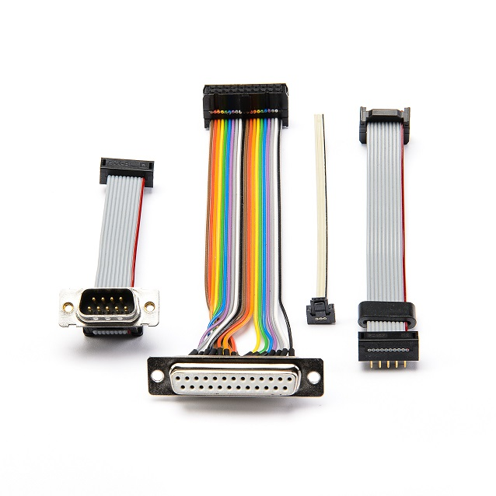
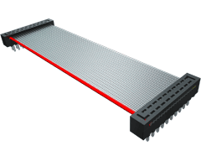
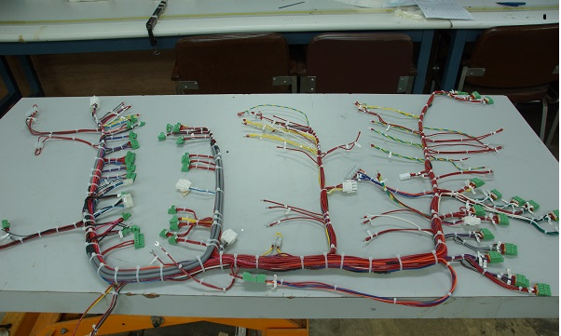
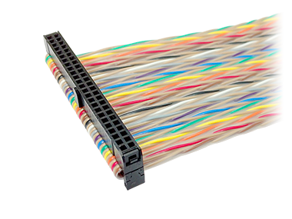
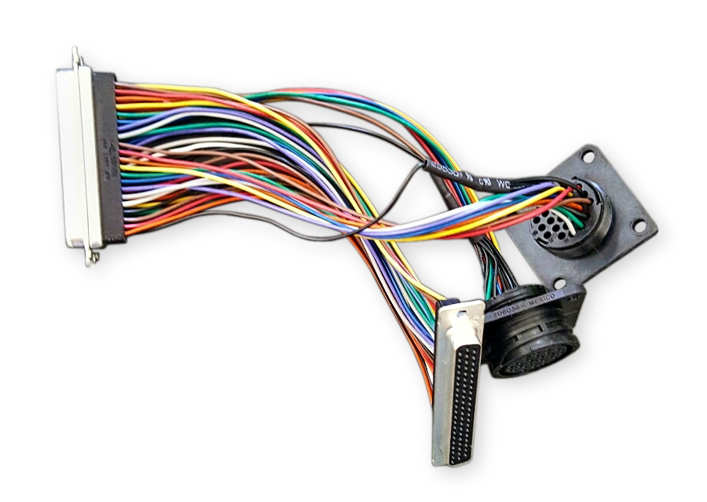
RIBBON & DISCRETE ASSEMBLIES

Slide 17
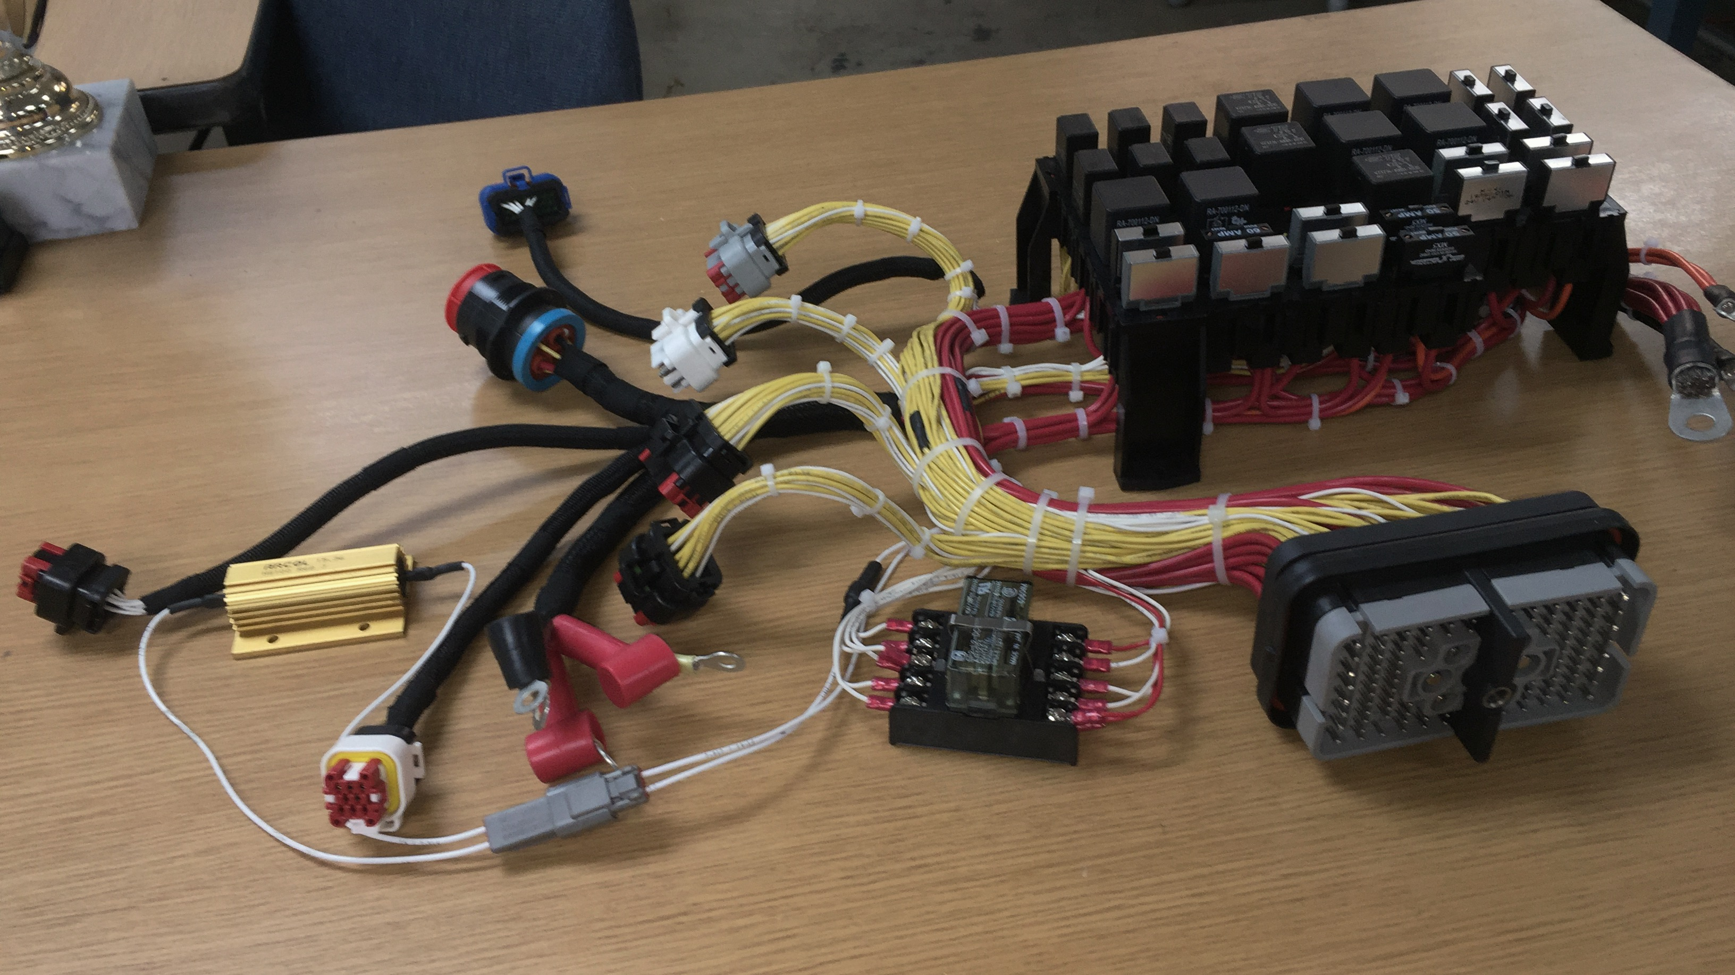
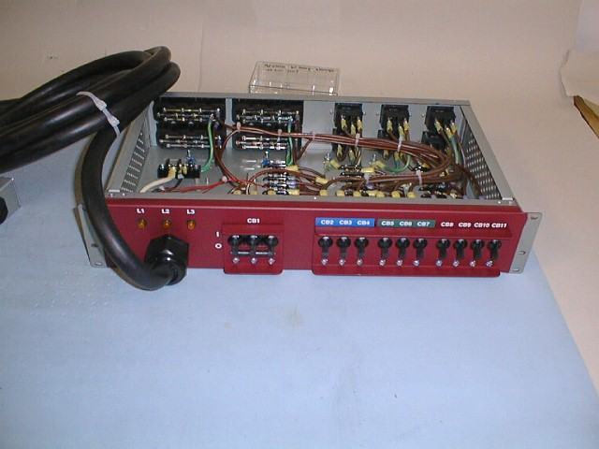
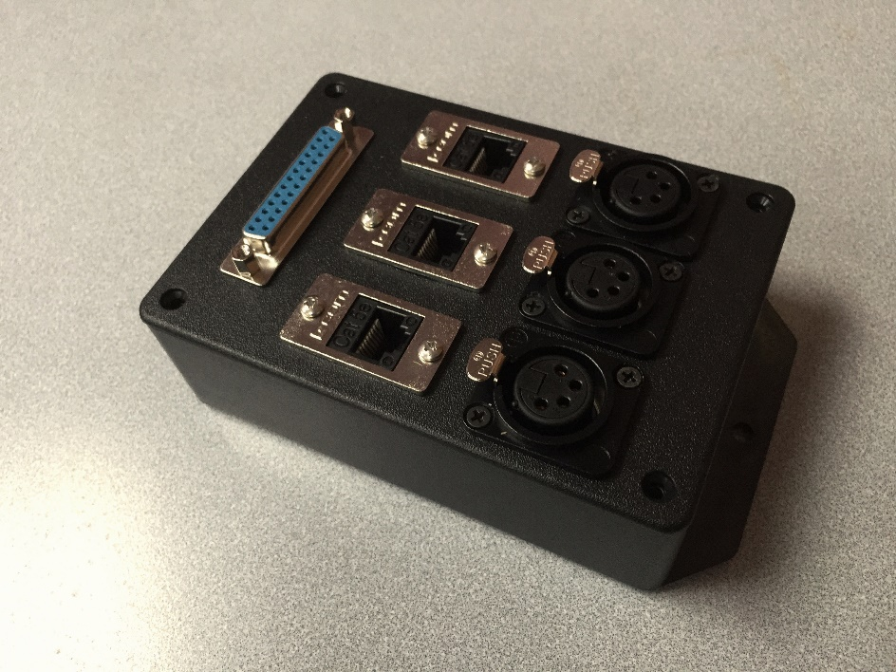
BOX BUILDS

Slide 18
CONTACT INFORMATION
Jack Williams, General Manager
jwilliams@phoenixmfg.com
Carmen Rivera, Customer Service
carmen.rivera@phoenixmfg.com
Maritza Crespo, Accounts Manager
mcrespo@phoenixmfg.com
Tel – (787) 882-7575
Fax – (787) 891-7630
Website – www.phoenixcablespr.com

